Slide 1
Analyzing how developers interact with genres
Adam Cooper

Slide 2
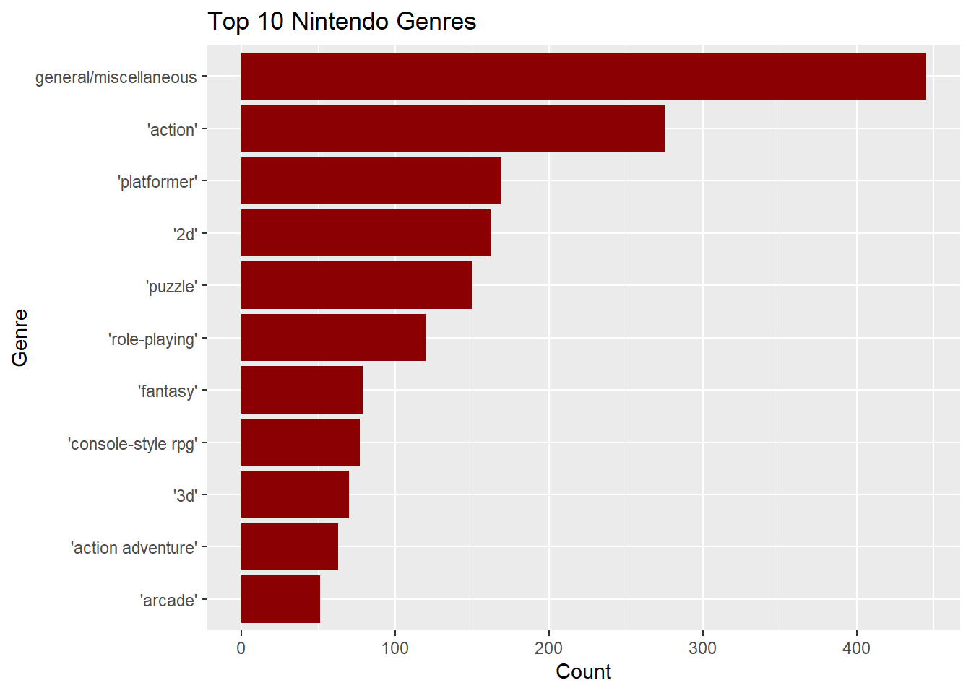
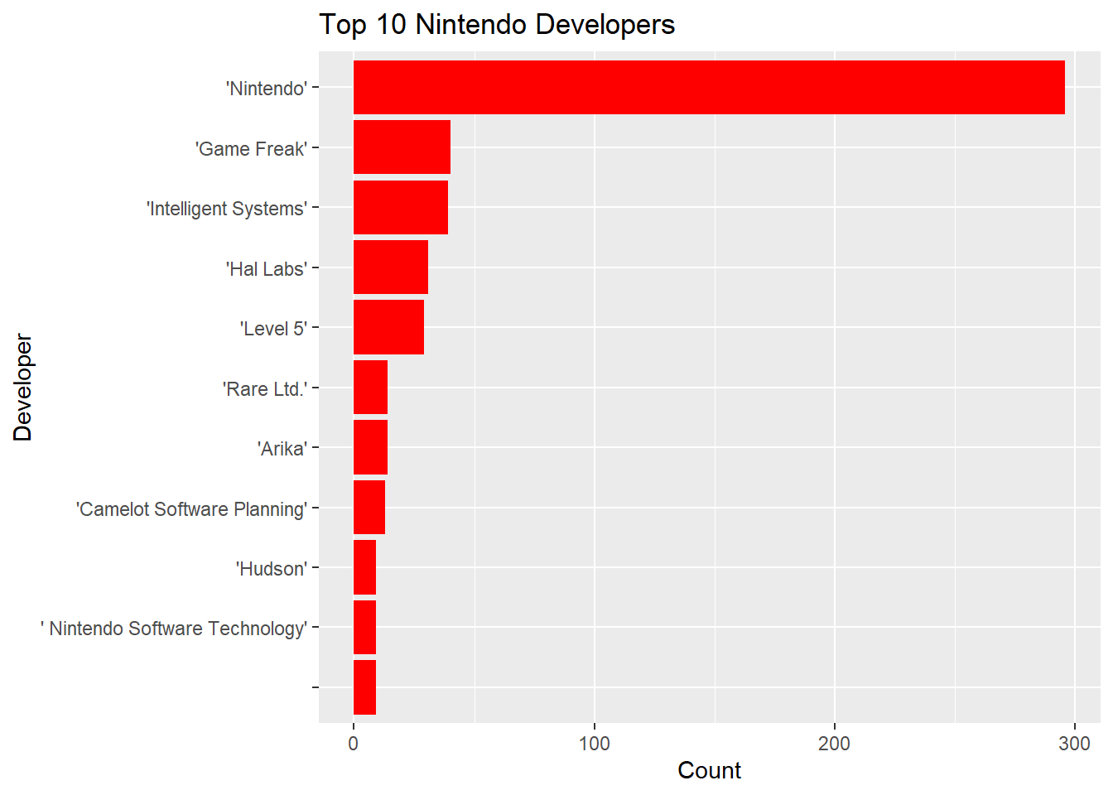
Summary of Data
Data Dimensions: 774 x 5
Cleaned: All null values and five columns
Variables left after cleaning: Title, User Score, Date, Developer, Genre
Variables of Interest: Developers and Genres

Slide 3
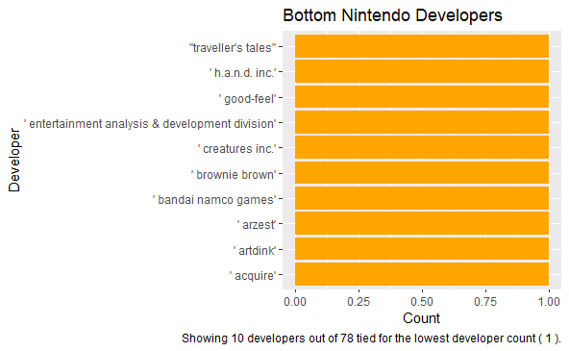
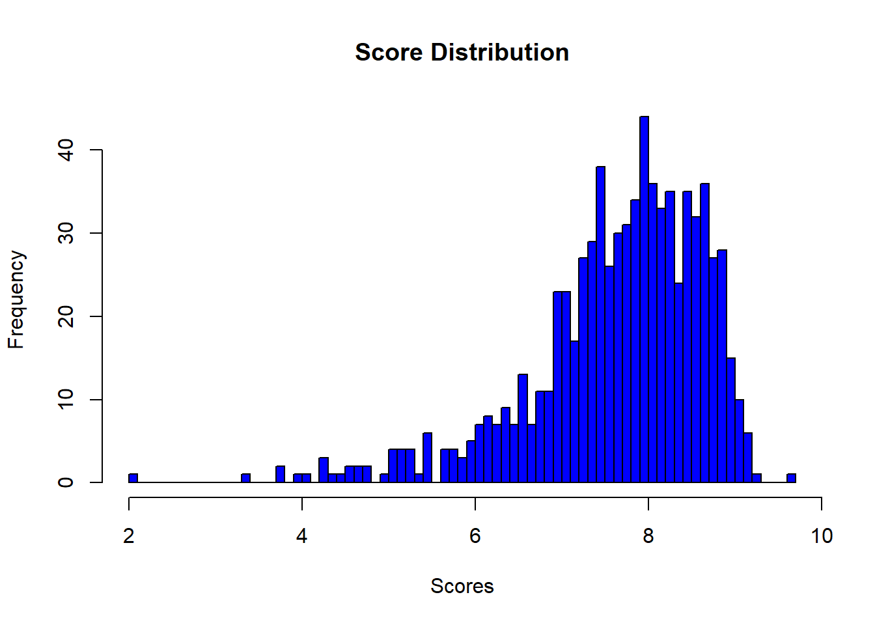
Statistics
There was a notable outlier: Pokémon HOME did poorly
An interesting part of this data set is that a lot of editing had to be done for it to work right.
There were many, many variables with null values.
Comparing each vector in each genre for each developer to get the result.

Slide 4
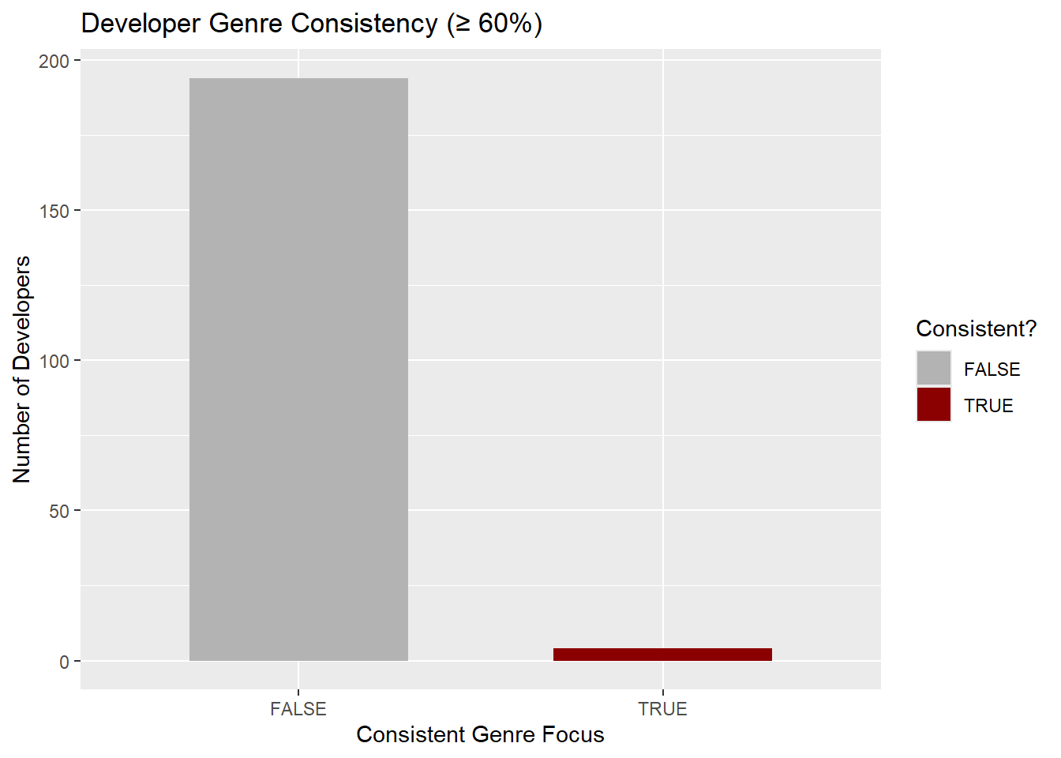
Visuals / Analysis
No.

Slide 5
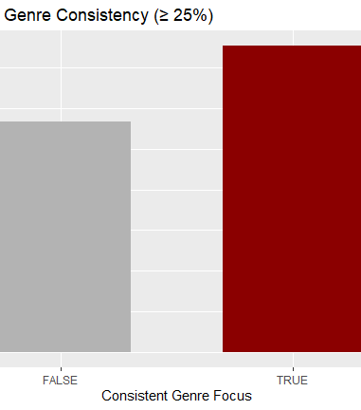
Results
So, no. There is no consistency between developers and genres. If I had to guess why, it is likely game companies would prefer to work with developers more consistently on gameplay similarities as opposed to genre similarities. That would still normally result in some overlap... but we do see that with a 25% consistency check.

